Slide 1

INTRODUCTION TO
CHALLENGE & CONQUEST

Slide 2
DO ANY OF THE FOLLOWING STATEMENTS APPLY TO YOU?
You are looking for new ideas for Catholic Youth Ministry.
You are stretched thin and want to ﬁnd a simple way to reach more teens each week by building a strong volunteer team.
You are searching for a dynamic, fun, Catholic curriculum that goes deep, answering the questions teens have about their life and faith.
You are interested in ready to use, ﬂexible, weekly curriculum that has enough material for the entire school year.
You want to offer activities that are interesting for both boys and girls and are different for middle school and high school groups.
You are trying to integrate attractive and meaningful service projects into the youth ministry activities in the parish and community.
You are considering small group mentoring with teen leaders and team based methods to create an experience where everyone feels important, accepted and part of a team.
You are looking for a comprehensive youth ministry program that combines online resources, training videos and hands on material for the adult leaders, teen leaders and the youth in the group.
You are a parent who wants to volunteer or start up a program in your child’s parish or school as a compliment or part of the youth ministry program.
You are a new or returning Challenge or Conquest adult leader who would like a brief summary of all that Challenge and Conquest youth ministry programs can offer to the kids in your group

Slide 3
WHAT is CHALLENGE
& CONQUEST?
Challenge & Conquest are Catholic Youth Ministry programs for boys and girls in 5th – 12th grade to grow in knowledge of their Catholic faith, friendship with Christ, and make a difference and positive impact on their families, friends and in the world around them. We also offer programs for boys and girls K-4th grade: Challenge Jr & Conquest Jr.

Slide 4
Our MISSION
FAST FACTS
Challenge and Conquest are proven to be a successful youth ministry option for the past 15 years in the US and Canada.
They are currently present in over 200 parishes & schools with over 6500 youth every week.
Challenge and conquest is led by 300 adult leaders and 700 teen leaders.
We offer over 40 summer camps with 2000 campers every year.

Slide 5
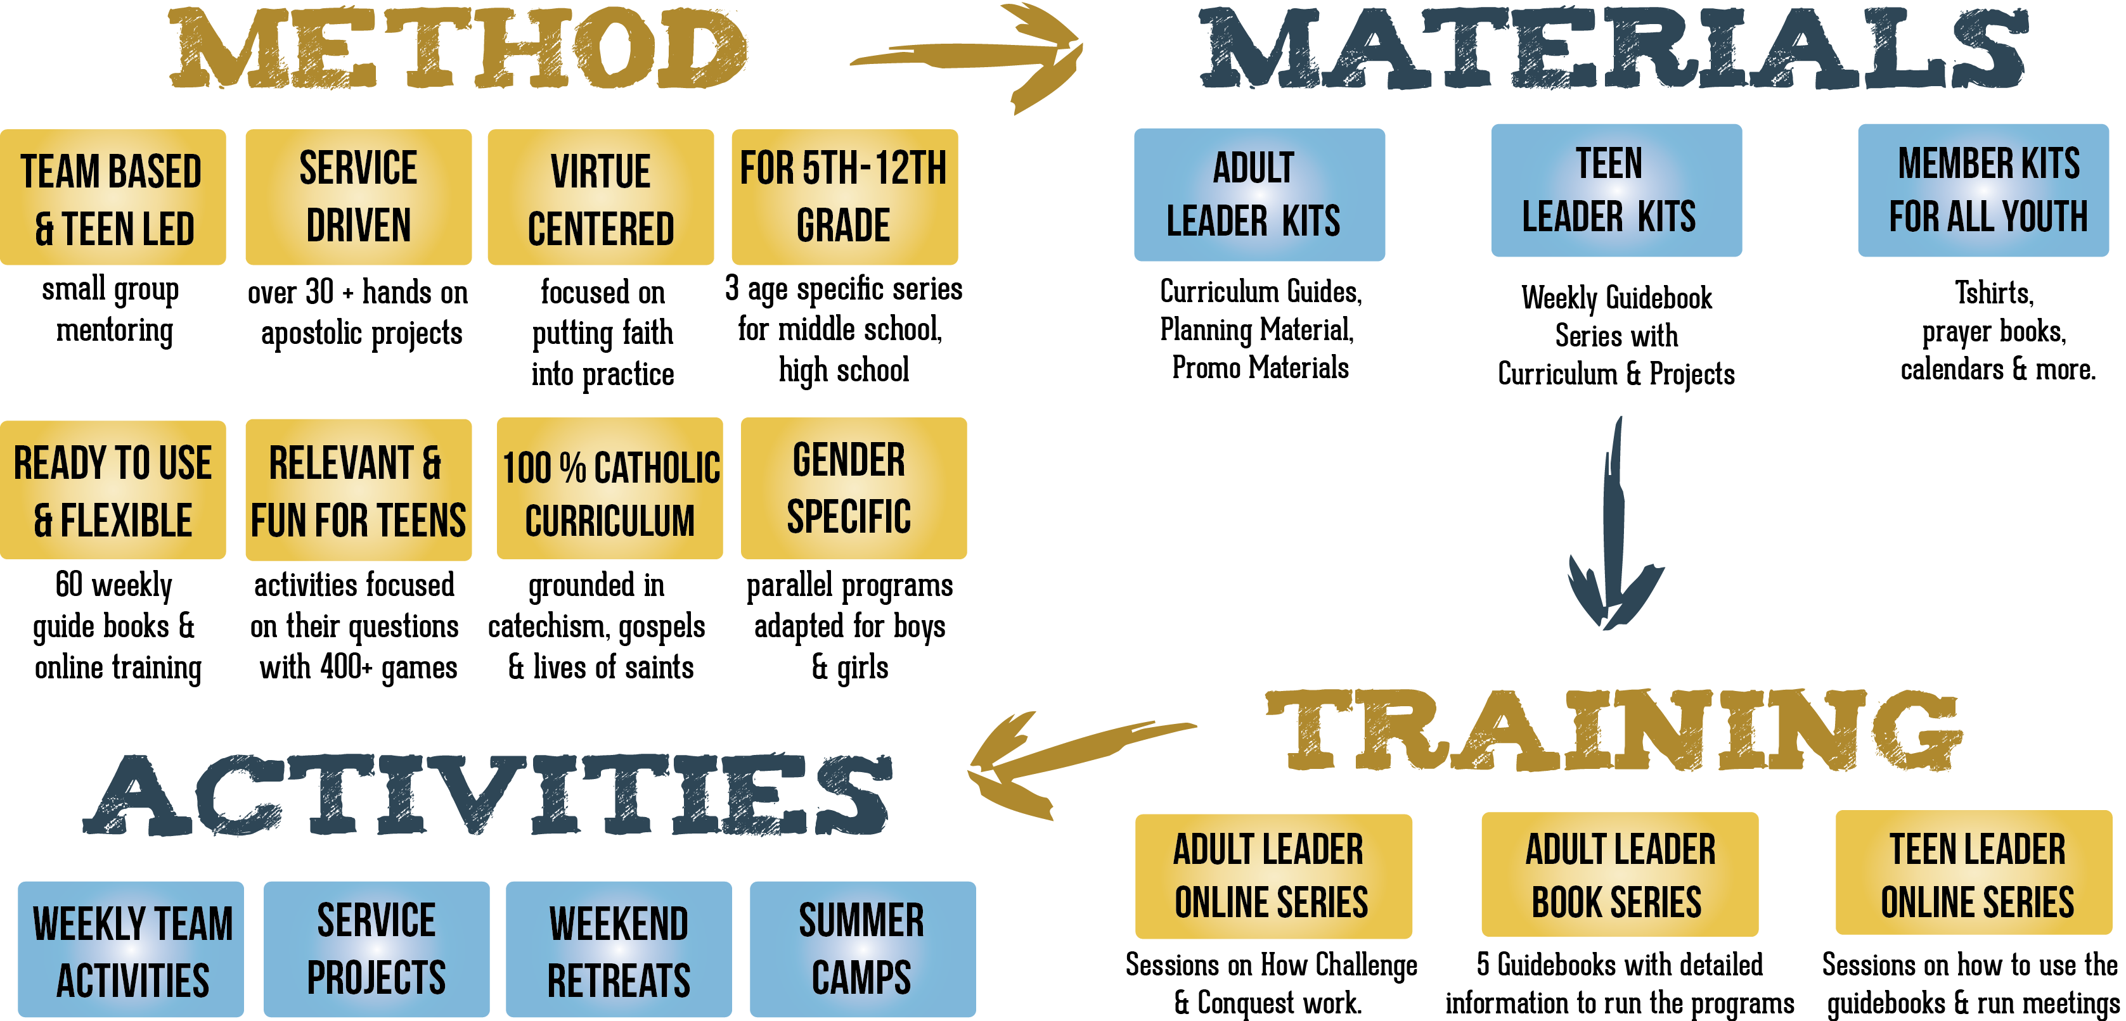
How it all works

Slide 6
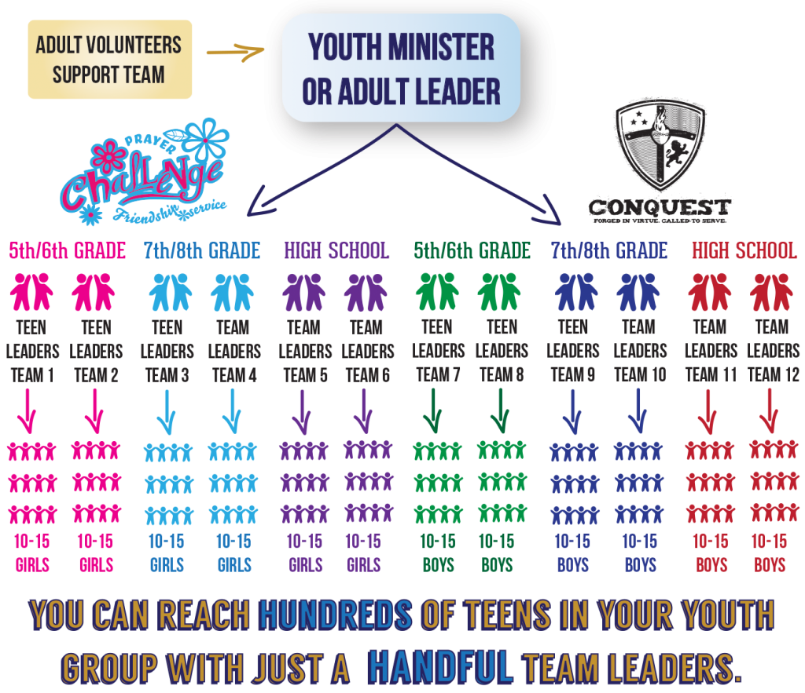
what do we mean by team based and teen led?
Conquest and Challenge are designed so that you organize your youth group into smaller teams of about 10-15 teens, who are around the same age.
Each team is led by 1 or 2 teen leaders who are usually 2 or 3 years older than the group they lead. This is small group mentoring or peer ministry where everything is done in teams especially the weekly activities and service projects.
The youth minister and adult leaders work with the teen leaders, training them and helping them prepare to lead their team activities each week. In this way, the youth group may be large in number but no one will feel lost in the crowd because they are part of a team with a team leader looking out for them.

Slide 7
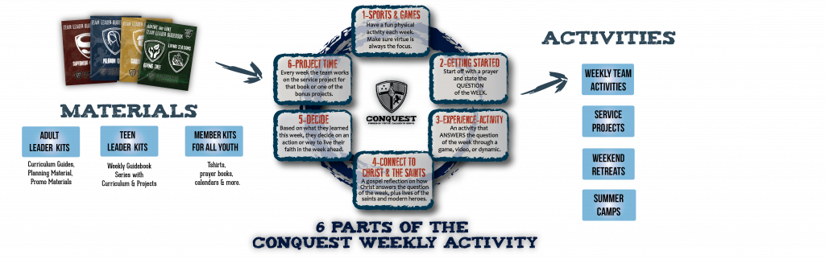
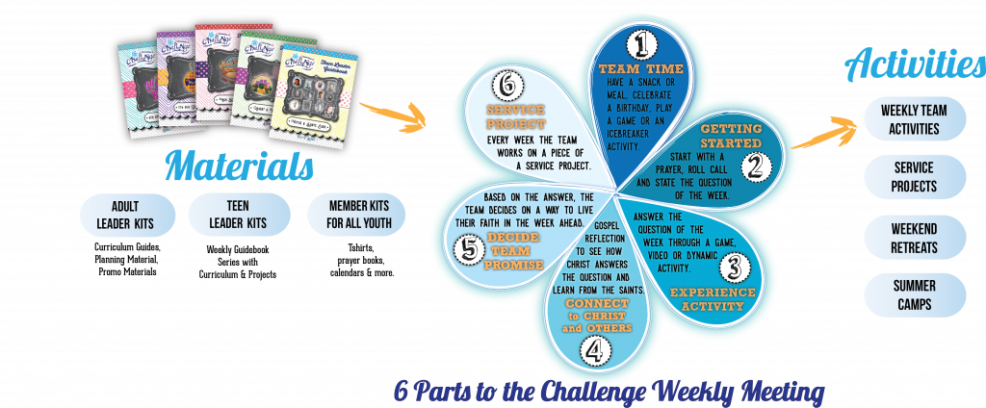
Putting the curriculum in the hands of the teen leaders
Peer mentoring is not only a life changing experience for the teen leaders, it truly makes an impact on the younger teens when they learn about their faith and see positive role models in their team leaders, who are only a few years older than they are.
The Conquest and Challenge curriculum is in the team leader guidebooks, and is written for teens to lead. We put the tools and materials in the team leader’s hands to mentor each week.

Slide 8

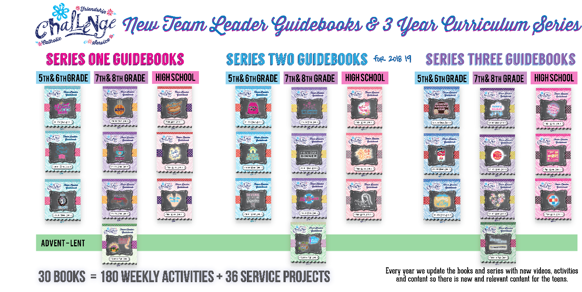
OUR curriculum:
Series 1-2-3 for 3 age groups
The Conquest and Challenge team leader guidebooks have 3 age specific curriculum’s: 5th/6th grade, 7th/8th grade, and high school. We offer 3 series of curriculum so that it is never repetitive. Both Conquest and Challenge offers 30 books in the curriculum series with over 180 weekly activities and 36 service projects (optional projects are also available as online resources). We offer 4 books each year, for each grade level. Each book contains 5-8 weeks of activities and 1 service project. Every year we update the books and series with new videos, activities, and content so it remains constantly new and relevant for the teens.

Slide 9
WHAT MAKES THE CURRICULUM UNIQUE?
QUESTION OF THE WEEK
In Challenge and Conquest, our curriculum is based off the questions teens have about God, their faith, the world, and themselves. The theme for each week is a question. The weekly activity in the Team Leader Guidebooks gives the team leader a path to lead the team down and discover the answer to the question of the week.
First, they turn to the YOUCAT to find a solid catechetical answer to the question. Then the team leader goes through the 6 parts of the Challenge or Conquest Weekly Meeting where they gain a better understanding of the question of the week.
Each weekly meeting has at least one game, activity or experience; relevant video clips; a gospel reflection to find how Jesus answered the question and at least one saint or story of someone who discovered the answer in their own life. The games are not listed on the charts. The curriculum and guide for each team’s weekly activity is in the Team Leader Guidebooks but we also have an online resource center with hundreds of printouts and additional material to help the team leader lead the meeting effectively.
On the Curriculum maps, you will see that Challenge and Conquest have the same theme or question each week but sometimes the saints, games and activities differ to work better with boys or girls.
The curriculum charts for SERIES 1, SERIES 2 and SERIES 3 can be found on the following pages. All three series curriculum charts are similar but with different questions, saints and gospels. We have a three year cycle so that it does not get repetitive for the teens. We also update & add new videos, activities and material each year to the curriculum.
GROUNDED IN CATECHISM
HUNDREDS OF GAMES & ACTIVITIES
HUNDREDS OF PRINTOUTS
ADAPTED FOR BOYS AND GIRLS

Slide 10
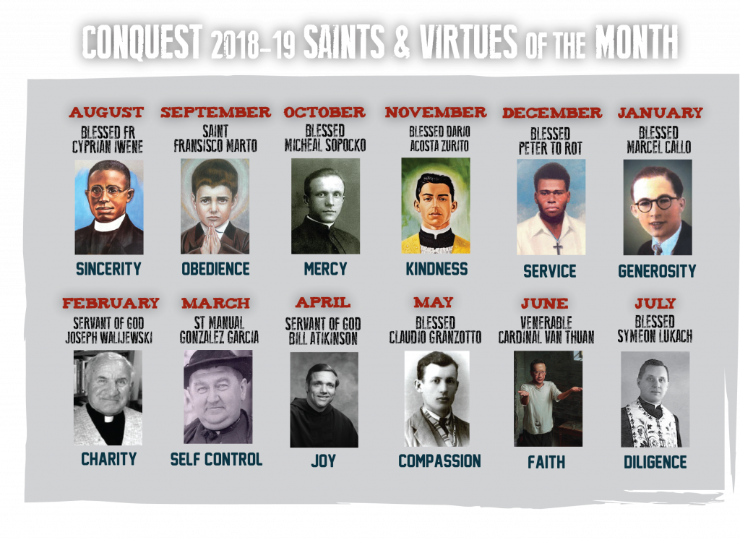
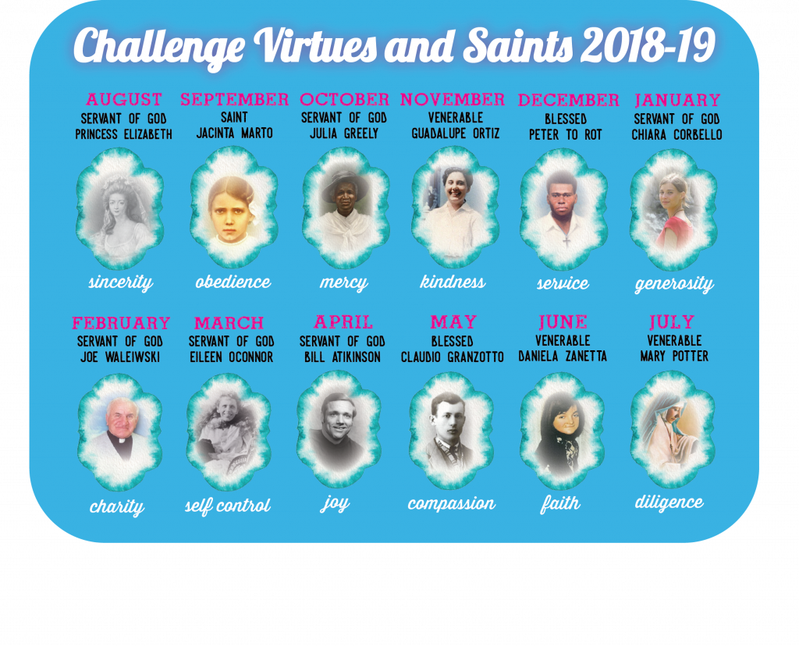

what do we mean by Virtue centered?
The virtue centered curriculum in Challenge & Conquest encourages teens to put their faith into action each week. The weekly meetings and activities encourage the teams to live out what they have learned. Every year we have new virtues & saints for each month. These are the virtues we encourage the teens to live for that month & to get to know the life of that saint. These saint & virtues can be found in the calendars which are included in all of our member, team leader and adult leader kits

Slide 11
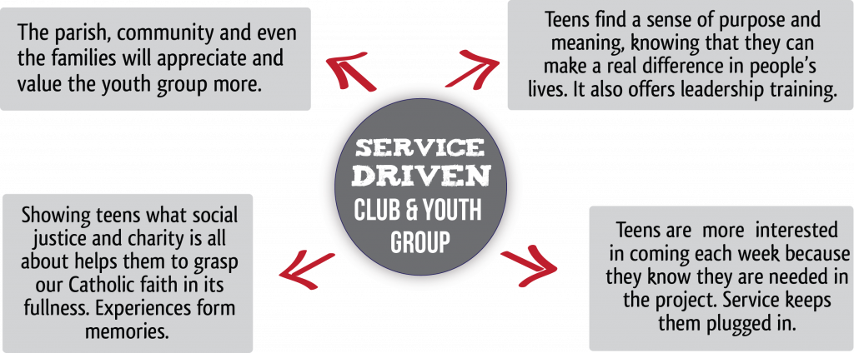
what do we mean by SERVICE DRIVEN?
In every guidebook there are AGE specific service projects that have been successful in Challenge & Conquest groups over the past 10 years.
On the following pages you can see the Challenge & Conquest service projects at a glance for each age level as well as the extra projects.

Slide 12
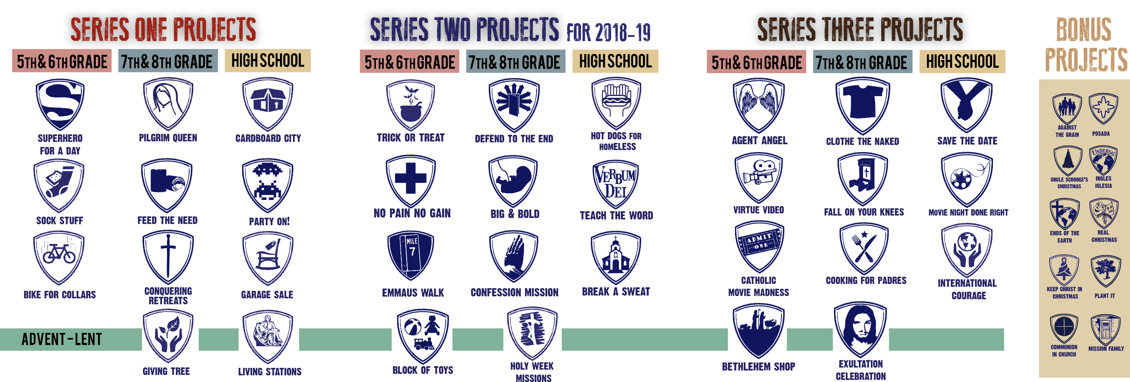
what do we mean by SERVICE DRIVEN?

Slide 13
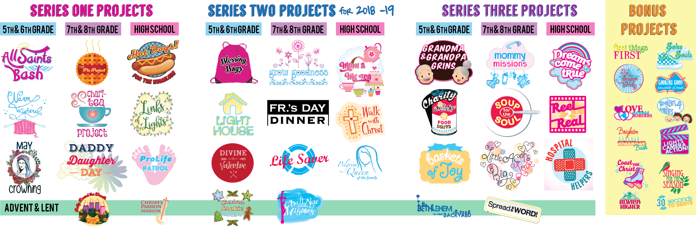
what do we mean by SERVICE DRIVEN?

Slide 14


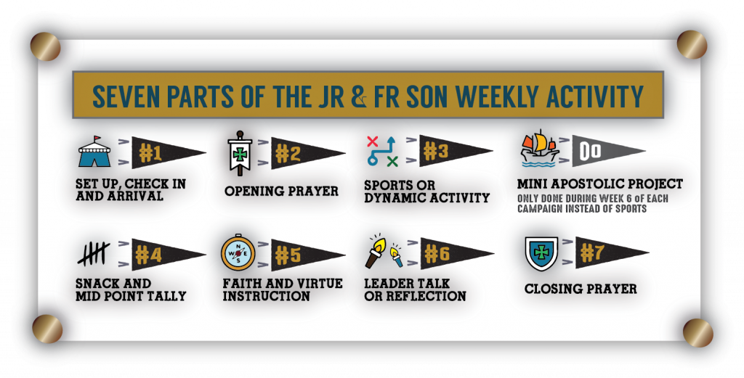
what is
CONQUEST JR?
The Conquest Junior Leadership Program is a weekly virtue based program for boys K-4th grade, ran by dads and youth leaders. The Jr Program has its own unique Conquest materials for this age group. This includes Curriculum, t-shirts, bags, & commitment cards specifically designed for the younger age group.

Slide 15


What is
CHALLENGE JR?
Catholic Faith and Virtue Program for Kindergarten thru 4th Grade
Challenge Jr is led by Adult Leaders, with the help of teen mentors. We have a complete Annual Program of Materials and Curriculum to help the girls and leaders successfully participate in the programs. The curriculum is virtue centered and includes both large group and smaller team activities. Challenge Jr is a great way to give the girls an opportunity to meet new friends.

Slide 16
www.challengeyouthministry.com www.conquestyouthministry.com
FOR MORE INFORMATION

