Slide 1


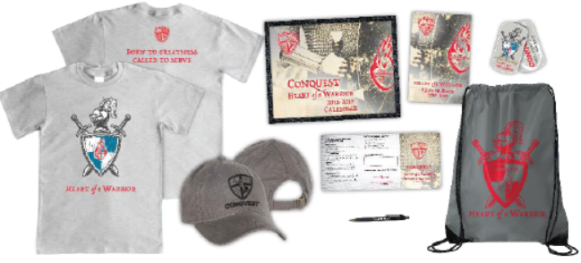
ATTENTION PARENTS
Make sure you have the TIZA font installed.
Save As a .pdf after editing to make your own!
Conquest Parent Night
Friday– August 18th
7:00 ~ 7:45pm
Parish Hall
New to Conquest?
Learn first hand how Conquest, a youth ministry leadership program of service, can help to instill virtue and form an apostolic heart in your son.
Veteran Parent?
Don’t miss this meeting! There are many exciting new changes and enhancements impacting your son.
It’s time to launch Conquest for 2018-19 and parents are invited to an exciting preview and presentation!
Agenda:
Meet the Conquest adult leaders
Preview the new Conquest curriculum!
Understand objectives and plans for the year
Convenient sign-up onsite!
Breakout session to meet adult and youth leaders!
Questions? <<CP NAME HERE >>Cp@email.com or (xxx)-xxx-xxxx
Preview New Kits
Called to Serve, Forged in Virtue

