Slide 1


Slide 2
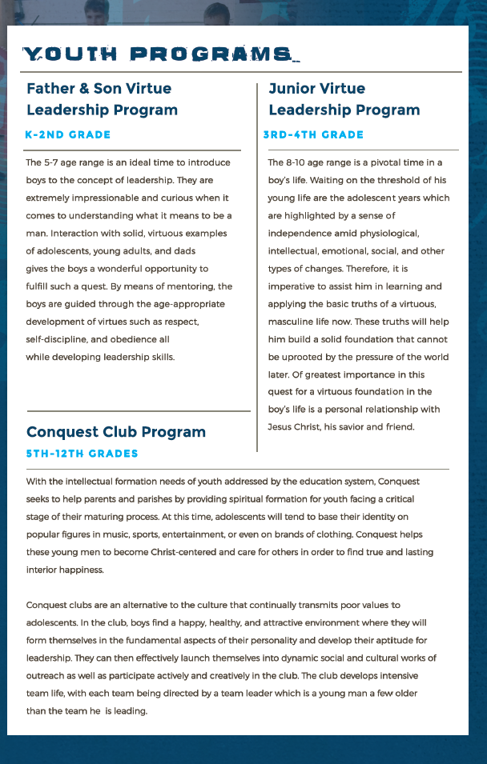

Slide 3
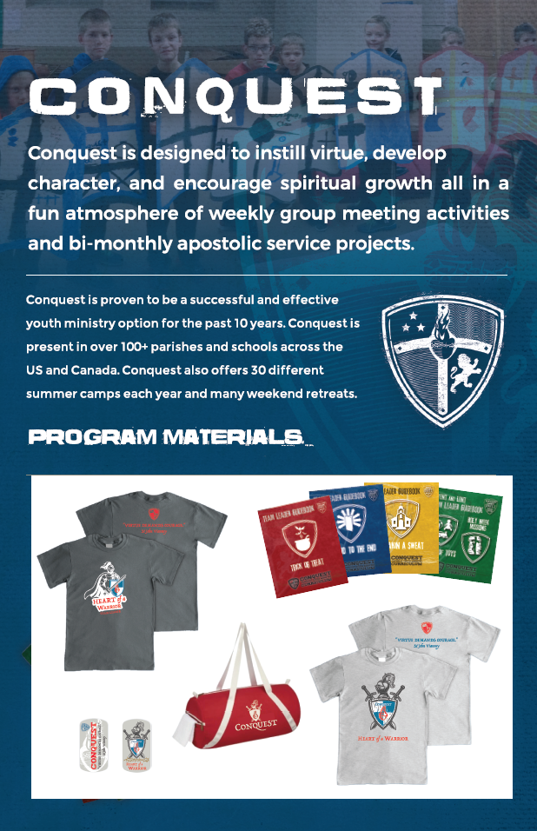

Slide 4

TYPE IN YOUR LOCAL CLUB INFORMATION HERE!
Local Conquest info:
Local club name:
Meeting place, day and time
Local club leader
Local club contact email
Local club contact phone

