Slide 1


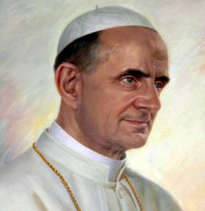

Patron Saints
Patron Saints
Bl. Paul VI
Virtue: patience
Feast Day: Sept. 26th

