Slide 1
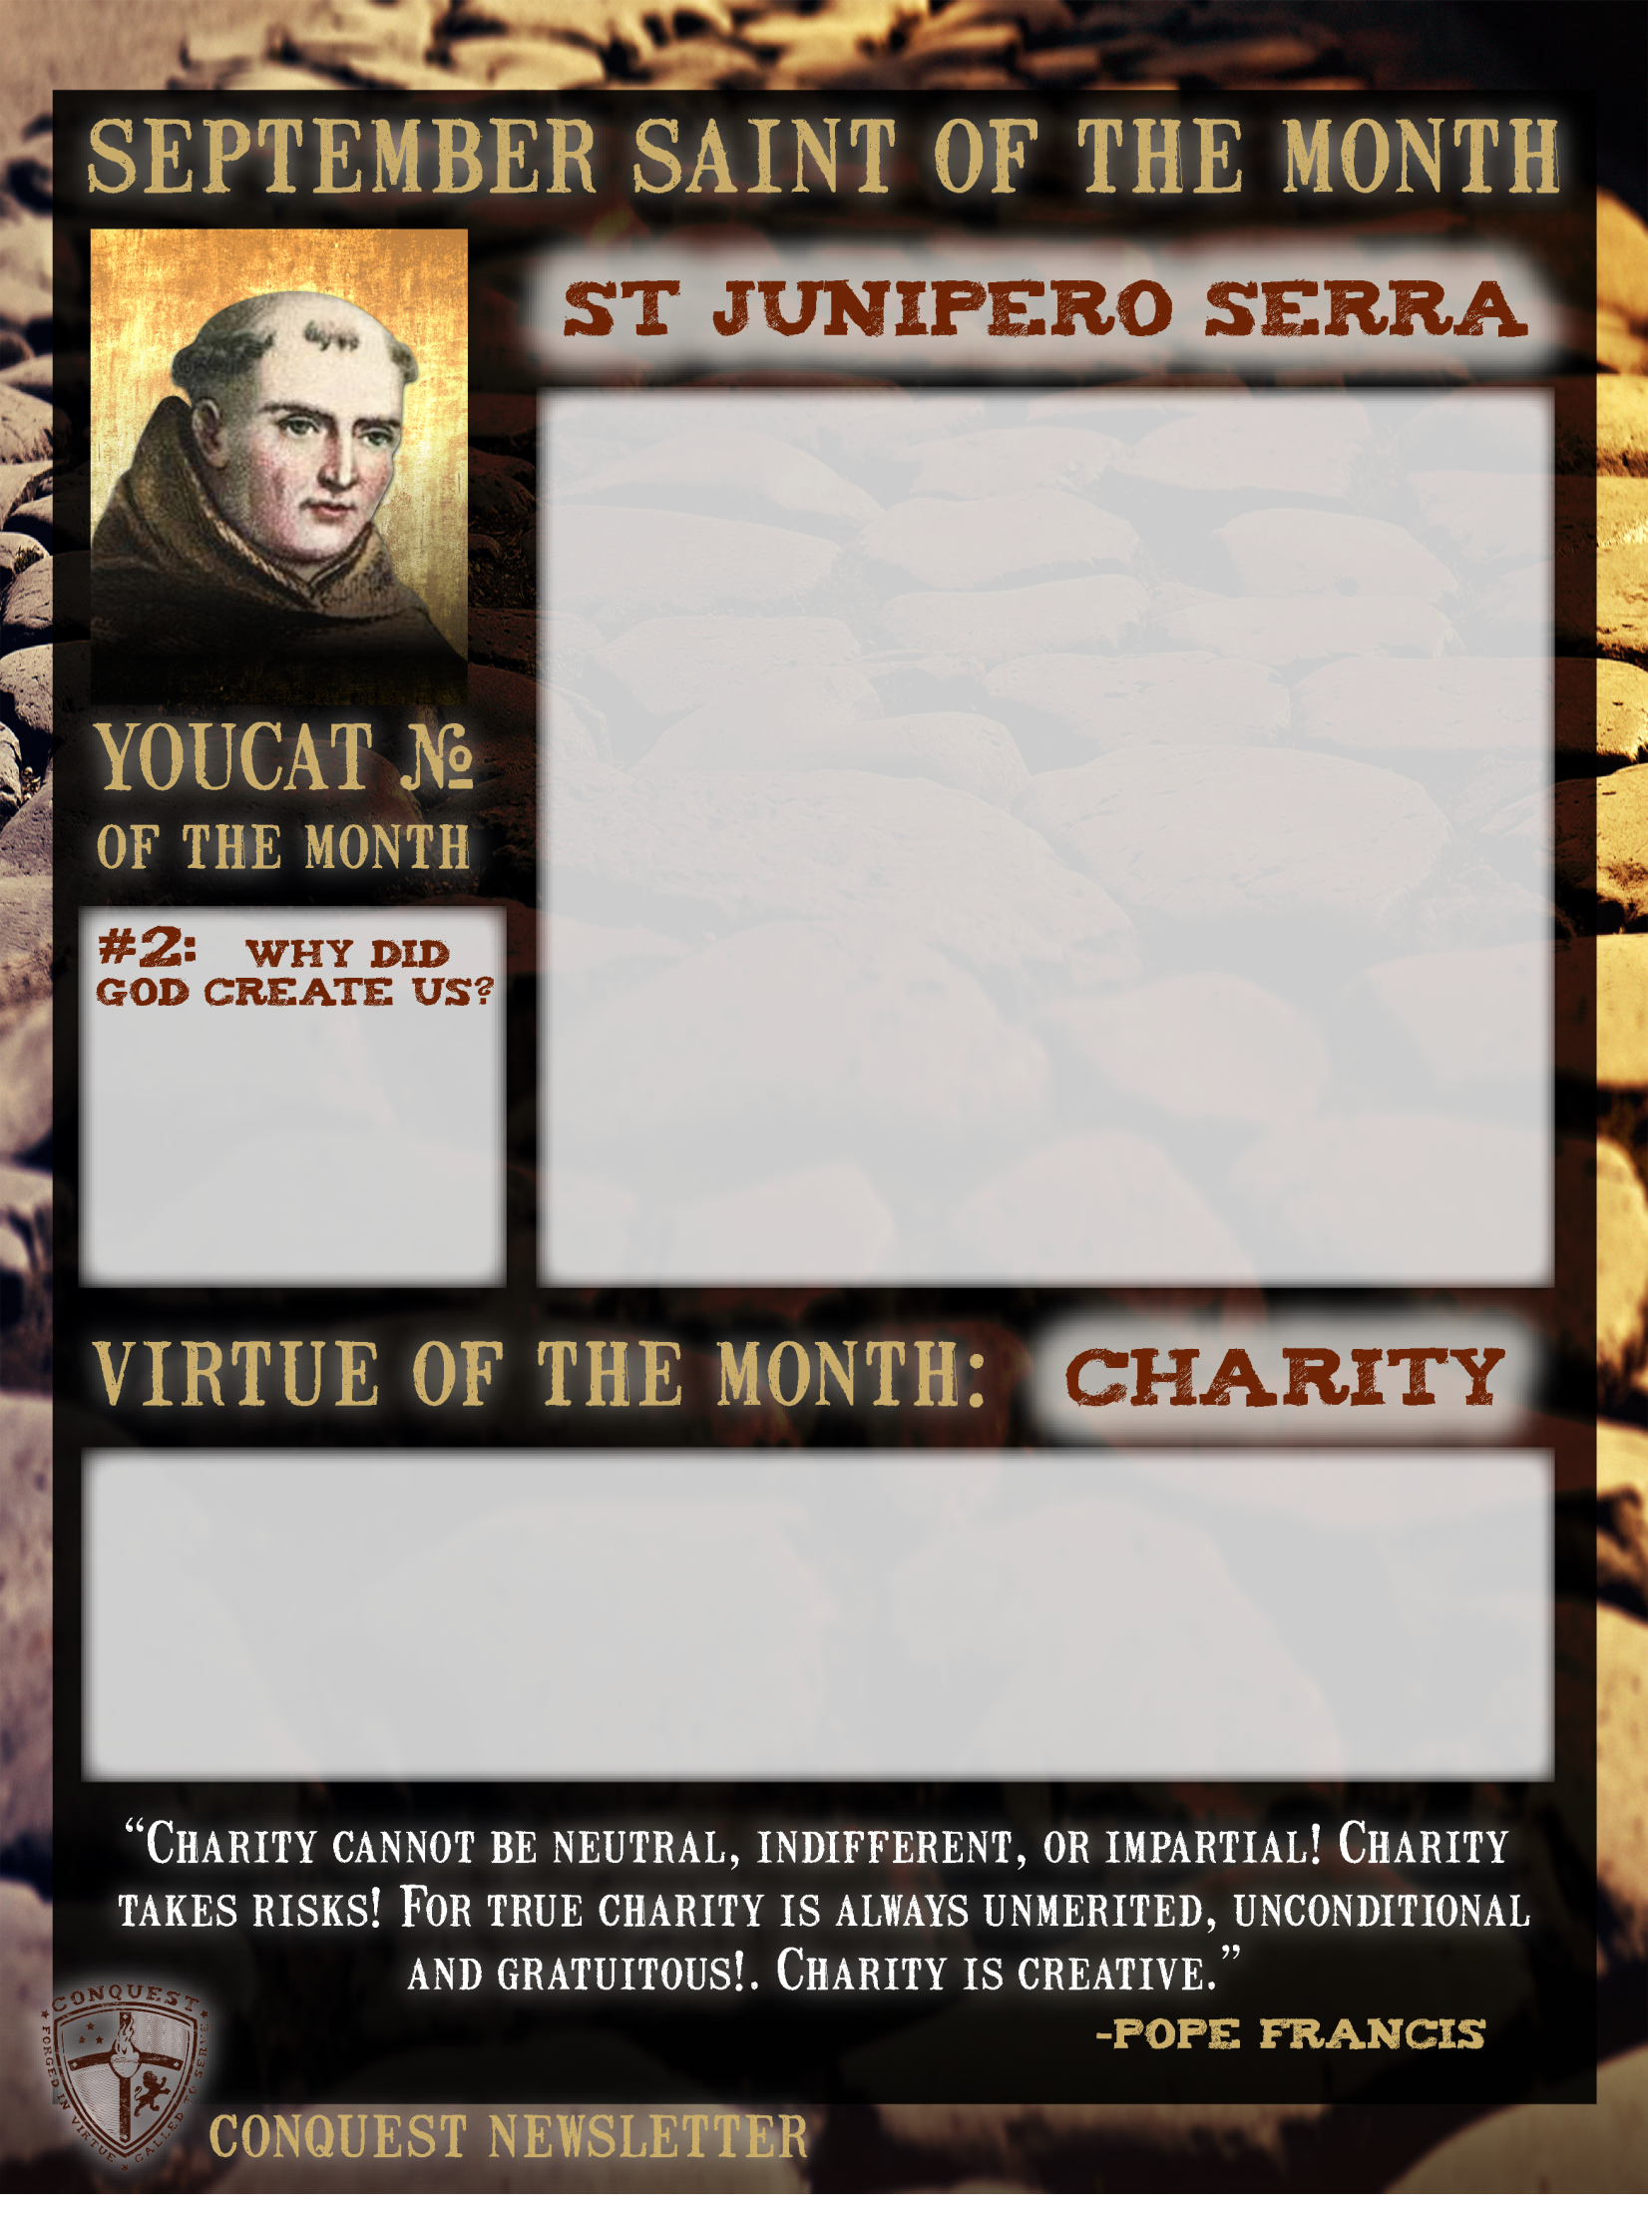
Miguel Jose Serra was born in Spain in 1713, and took the name of Junipero when he entered the Franciscan Order. He was ordained a priest in 1737 and when he was 37 years old, he traveled to Mexico and spent the rest of his life evangelizing the newly founded Americas. He was once bitten by a snake and suffered from it throughout his life, though he continued to make his journeys on foot whenever necessary. Father Serra took over the missions in California stretching from San Diego to San Francisco. He was in a large part responsible for the foundation and spread of the Church on the West Coast of the United States when it was still mission territory. He founded twenty-one missions and converted thousands of people. The people in the missions were not just taught the faith. They were taught methods of agriculture, cattle raising, and arts and crafts. He brought to California the European products that eventually became central to the state’s agriculture empire: oranges, lemons, olives, figs, grapes, and vegetables, as well as cattle, sheep, goats, and horses. He suffered intensely from his crippled leg yet he would visit all of his missions from San Diego to San Francisco, traveling more than 600 miles in the process, in order to give the sacrament of confirmation to all who had been baptized. He confirmed over 5000 people. He died in 1784, worn out by his apostolic labors. He was beatified by Pope John Paul II in 1988 and Pope Francis canonized him on September 23rd, 2015. His feast day is July 1st.
God created us out of free and unselfish love….Out of the “surplus” of his love he created us. He wanted to share his endless joy with us, who are creatures of his love.
Charity is simple – love people as God would love them. So why is it such a hard virtue to put into practice? Probably because it means we have to forget about ourselves and put the other person first. We have to change our priorities. That may mean to glance up from our phone or tablet to look around at the needs of others. It may mean to stop what we are doing and change our plans to help someone in need. Charity may be as easy as just listening to someone who is lonely. There is a trick to living charity if it does not come naturally to you. Plug into the Holy Spirit! Many people wonder what kind of relationship we can have with the Holy Spirit every day. He is the Spirit of Love, the Great Consoler. He can inspire us and point out things we may miss to help us live the virtue of charity.

